Slide 1
ISCG 7446
Advanced Data Engineering
Sreenivas Sremath Tirumala

Slide 2

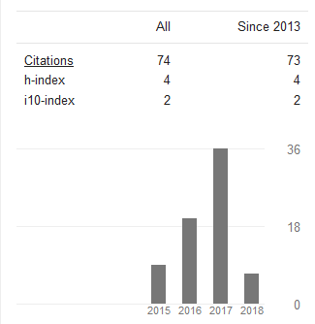

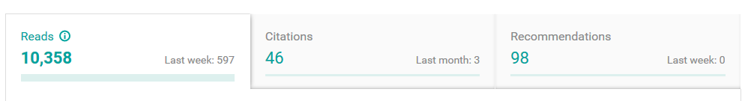
About Me
PhD (from AUT)
  Data warehousing (Level 7 & 8)
  Introduction to Databases
Industry Experience
  Project Manager
  Business analysis
  Consultant
  Programmer (C#, SQL Server VB.NET)
  Multimedia Web Development
  Intro to Programming (Python)
  Database Design and Development
  Programming in C (AUT)
  Business Systems Analysis
  Nature Inspired computing (AUT)
Artificial Neural Nets
Deep Learning
Cyber security
Business Intelligence
  Multimedia Programming
  Advanced Data engineering
  Mobile software Development
  GUI Programming
  Information Systems Concepts
Project Supervision
Master of Computing (Honours)
Unitec Institute of Technology, 2014
Contact:
stirumala@unitec.ac.nz
Strictly by prior appointment

Slide 3
Introduce Yourself

Slide 4
Learning & Teaching
12 Weeks of course schedule
30 mins to 50 mins lecture
Activity based Collaborative learning
Assessment based sessions
Research oriented approach
Expects considerable self study
Students who miss classes will find it difficult to pass this course

Slide 5
Course Structure
12 session of teaching, learning and research
Two Assessments (will be clarified at the later sessions)
  Assignment 1 (40%) – Individual
  Assignment 2 (60%) – Group
How to Pass
Don’t miss a class
Initiate your work in the class
Group discussion
Complete prerequisites for each week
Talk to your Lecturer
Practical implementation
Ubuntu
MySQL
Windows
Java

Slide 6

miss the initial 30 mins
come late
Talk loudly
use mobiles
social media
leave the class without informing
make loud noise
Don’t ask me if you want to go out for
Water
Wash room

Slide 7


Slide 8
Class Activity
What is Big Data ?
Microsoft
Examples
Volumes, Variety, Velocity, Veracity
Applications
IBM
Activity – i and ii

Slide 9
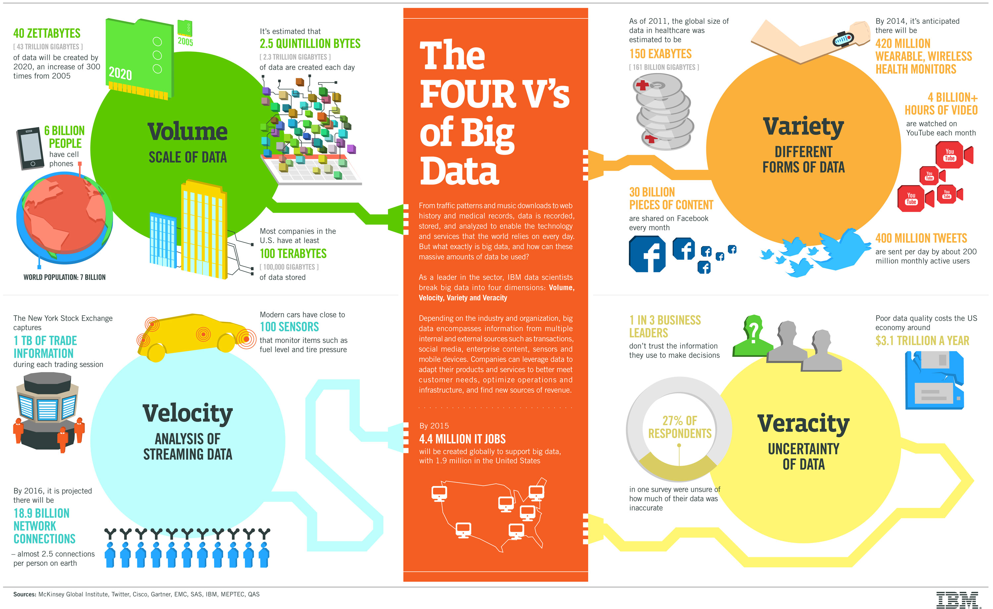

Slide 10
Class Activity
Information science is an interdisciplinary field primarily concerned with the analysis, collection, classification, manipulation, storage, retrieval, movement, dissemination, and protection of information (Wikipedia,2017)
Data science, also known as data-driven science, is an interdisciplinary field about scientific methods, processes and systems to extract knowledge or insights from data in various forms, either structured or unstructured,
similar to Knowledge Discovery in Databases (KDD). (Wikipedia,2017)
What is Data Engineering ?
Activity -iii

Slide 11
Data Engineer
Using data to understand process
Suggest new / change implementations
Improve the performance
Batch processing of Data
Real time processing of Data

Slide 12
Class Activity
Data Analyst
Business Intelligence Developers
Data Engineer
Data Scientist
Big Data University - Blog,2017
Activity -iv

Slide 13
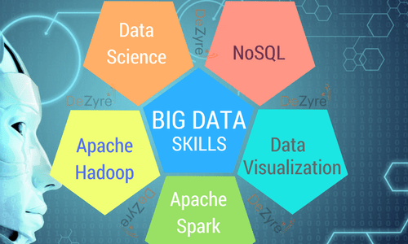
(Kushbhu, 2017)

Slide 14
Data Engineer Skills
Data Analysis: MapReduce, Hadoop or data mining, Machine Learning
Data Warehousing: large data stores, In and out
Data Transformation: ETL
Data Collection: Data extraction from Web / Database or API based systems

Slide 15
Data Engineer Requirements
Proficiency with Hadoop v2, MapReduce, HDFS
Good knowledge of Big Data querying tools, such as Pig, Hive, and Impala
Experience with Spark
Experience with integration of data from multiple data sources
Experience with NoSQL databases, such as HBase, Cassandra, MongoDB
Knowledge of various ETL techniques and frameworks, such as Flume

Slide 16
Class Activity
Exploring resources
IEEE Transactions on Big Data
Microsoft, Google, FB, Oracle, IBM success stories
Domain based application like Telecom, Marketing, health care
White papers, Research articles, Conference key notes etc.
Feb2013ColinWhite.pdf

Slide 17
Data Engineering - Activity
Statistical analysis and modelling.
Database architectures.
Hadoop-based technologies (e.g. MapReduce, Hive and Pig)
SQL-based technologies (e.g. PostgreSQL and MySQL)
NoSQL technologies (e.g. Cassandra and MongoDB)
Data modelling tools (e.g. ERWin, Enterprise Architect and Visio)
Python, C/C++ Java, Perl.
Raise of Big Data
Profile
Skills
Life of Big Data Engineer

